Slide 1
Decoding the WannaCry Ransomware Attack
education
fix
how
future
about
spread
Thank You
Outcomes
impact
MADE BY BESSEL BINNY
RA2111030010145

Slide 2

Understanding the WannaCry Ransomware Attack
education
WannaCry is a ransomware attack that targeted computers running Microsoft Windows OS.
Organizations worldwide faced data encryption and demanded Bitcoin ransom for decryption keys.
The WannaCry outbreak occurred in May 2017, affecting over 200,000 computers in 150 countries.
In addition to exploiting the EternalBlue vulnerability, WannaCry also spread through other methods, such as brute-force attacks on Remote Desktop Protocol (RDP) services and internet-facing systems with open SMB ports.
future
fix
how
about
spread
impact
Thank You
Outcomes

Slide 3

education
fix
how
future
about
spread
impact
Background: WannaCry ransomware exploited a vulnerability in Microsoft Windows operating systems, leveraging the Eternal Blue exploit allegedly developed by the NSA.
It spread rapidly through networks, encrypting files and demanding ransom payments in Bitcoin for decryption.
The attack targeted a wide range of organizations, including government agencies, healthcare institutions, financial services firms, and multinational corporations.
Thank You
Outcomes

Slide 4
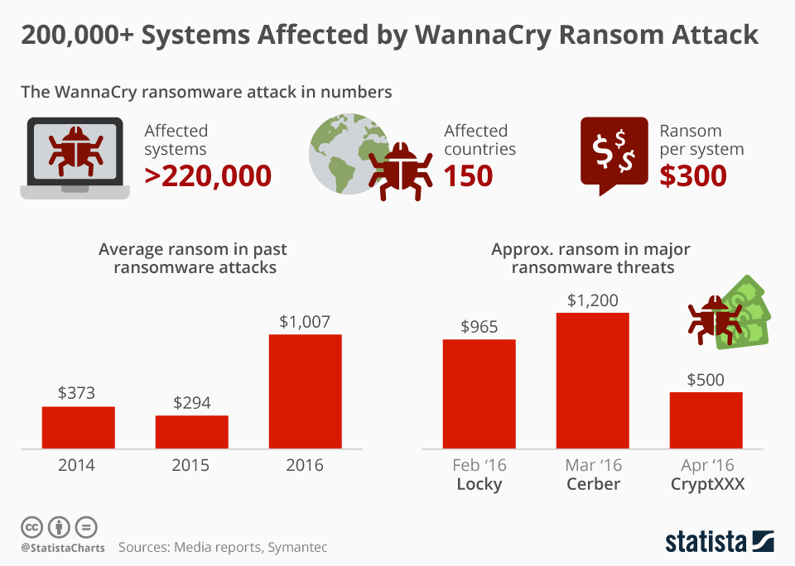
Impact of WannaCry
Outcomes
education
fix
how
future
about
Thank You
spread
impact

Slide 5

Initial Detection and Assessment: Organizations such as the National Health Service (NHS) in the UK, Telefonica in Spain, and FedEx in the US were among the first to detect and assess the WannaCry outbreak. Incident response teams swiftly mobilized to contain the spread and minimize the impact on critical services.
Vulnerability Identification: Penetration testing teams across various sectors analyzed WannaCry samples and threat intelligence to identify the specific vulnerability exploited by the ransomware. They conducted vulnerability scans to detect unpatched systems susceptible to the Eternal Blue exploit.
Patch Management: Companies including Renault, Deutsche Bahn, and Nissan prioritized patching vulnerable systems to mitigate the risk of WannaCry infections. Patch management processes were accelerated to ensure rapid deployment of security updates across all endpoints and servers.
Thank You
education
fix
how
future
about
spread
impact
Outcomes

Slide 6
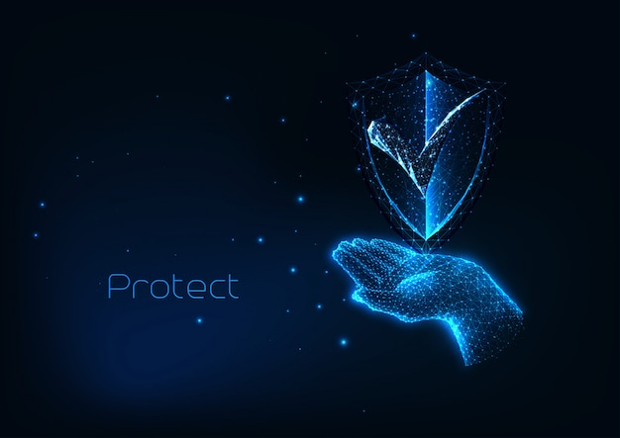
The concerted efforts of organizations and cybersecurity professionals worldwide yielded significant outcomes in response to the WannaCry outbreak:
Mitigation of WannaCry infections across diverse industries through timely patching and the implementation of network segmentation strategies.
Enhanced email security defenses, reducing the success rate of phishing attacks and subsequent ransomware infections.
Strengthened incident response capabilities, enabling organizations to contain WannaCry outbreaks swiftly and minimize disruption to critical services.
Heightened awareness of cybersecurity risks and the importance of proactive defense measures across industries, governments, and global organizations.
education
fix
how
future
about
Thank You
spread
Outcomes
impact

Slide 7

The WannaCry ransomware attack spread through a vulnerability called EternalBlue. EternalBlue targeted a flaw in Microsoft's SMB protocol used by Windows systems, allowing attackers to remotely execute code without user interaction. Infection: WannaCry combined EternalBlue with ransomware, infecting systems and encrypting files. It then spread through networks by scanning for vulnerable systems. Propagation: Upon finding a vulnerable system, WannaCry used EternalBlue to infiltrate and infect it, rapidly spreading the ransomware across networks. Ransom: Infected systems displayed ransom notes demanding payment in Bitcoin for decryption keys, threatening permanent file loss if payment wasn't made. Impact: The combination of WannaCry's ransomware payload and EternalBlue's propagation capabilities led to one of the largest and most disruptive cyberattacks in history.
spread
education
fix
how
future
impact
about
Thank You
Outcomes

Slide 8
THANK YOU
education
fix
why
future
about
spread
impact
Thank You
Outcomes

